Slide 1
Arrays and Pointers

Slide 2
The why and what of arrays
Remember the sort program. Even to sort 5 numbers, the program is somewhat complex. What would it look like if we sorted 500 numbers? Is there a way to use a loop to deal with the 500 numbers and avoid having to name 500 different variables? Yes, this is the main motivation for arrays.
To have n doubles stored contiguously in storage we use an array. We give the array a name, such as sort_input[n] and we talk about the kth element by saying sort_input[k]. For example:
  double sort_input[500];
  for ( j=0; j< 500; j++)
  scanf(“%lf”, sort_input[j]);
In a one-dimensional array ( the most common form). The syntax is
  data_type identifier_name[constant_integer_expression];
  data_type is the familiar int, or float, or double, or char, etc.
  identifier_name is simply the name of the array.
  constant_integer_expression is an expression that must be a constant and evaluate to an int. The compiler needs a constant so it knows how much storage to set aside.
The first element of an array is always indexed by 0. e.g. sort_input[0] = 3;

Slide 3
One-Dimensional Arrays
You use a one-dimensional array when you think of the data as being different instances of the same sort of thing, and the only difference is the actual value. For example, it is natural to use a one-dimensional array to hold the list of grades of students on a given assignment.
double exam1[170]; /* storage for 170 student exams */
Or for all assignments for one student:
double jims_scores[10]; /* sets up storage for 10 grades. */
Notice that if you wanted to set up all assignments for all students, there are two things you need to know before you know which score you want, you need to know the student and the assignment number. Because you need more than one fact to determine which score you want, you wouldn’t normally use a one-dimensional array. We will see two-dimensional arrays a little later.

Slide 4
Fill_and_print program
Write a small program that fills an array, prints out values and sums the elements read.

Slide 5
Fill_and_print program
/* Fill and Print an array. */
#include <stdio.h>
#define N 5
int main(void){
int a[N]; /* allocate space for a[0] to a[4] */
int i, sum = 0;
for ( i = 0; i< N; ++i)
a[ i ] = 7 + i * i;
for ( i = 0; i< N; ++i)
printf(“a[%d] = %d “, i , a[ i ] );
for ( i = 0; i< N; ++i)
sum += a [ i ];
printf(“\nsum = %d\n”, sum); /* print the sum */
return 0;
}
Output is:
a[0] = 7 a[1] = 8 a[2] = 11 a[3] = 16 a[4] = 23
sum = 65

Slide 6
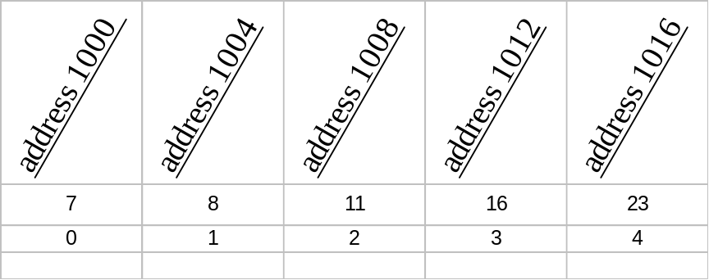
Fill_and_print program: Dissection
#define N 5
We will normally use a preprocessor define to accommodate the size of the array. In this case we name it N. The preprocessor will replace every N with the constant 5. This allows us to change all instances of the size of an array in one place.
int a[N]; /* allocate space for a[0] to a[4] */
After the preprocessor substitutes 5, the compiler sees….
int a[5];
Five consecutive locations in memory will be reserved to hold values for the elements (aka members) of the array.
If the size of an int on this machine is 4, and the first array element is stored at address 1000, then the next will be stored at 1004, the third at 1008, etc. We could draw it this way:
a
Values of the elements of a
element number

Slide 7
Fill_and_print program: Dissection continues
for ( i = 0; i< N; ++i)
This is the classic way to step through an array, note after the substitution for N, the compiler sees:
for ( i = 0; i< 5; ++i)
Because we used the #define, to make the program work for an array of size 6, our only change would be:
#define N 6
Also notice that we used i < 5 as the termination condition, a[5] is not a valid reference.
Our for statement essentially says for every element of the array do the following:
a[ i ] = 7 + i * i;
When i is 0, the 0th element is filled with 7, then I becomes 1 and the next element becomes filled with 7 + 1 * 1, i.e. 8. Then I becomes 2, and the next element becomes 11, etc.
for ( i = 0; i< N; ++i)
printf(“a[%d] = %d “, i , a[ i ] );
Notice how the expressions within the for loop are identical. I told you it is the classic way to do something to every element. In this case, the printf causes the element to be printed.

Slide 8
Fill_and_print program: Dissection conclusion
for ( i = 0; i< N; ++i)
sum += a [ i ];
Our third for loop, adds, in turn, each element in the array to the identifier sum. Once again, notice that the three expressions in the parenthesis are identical to the two earlier for loops.

Slide 9
Array Initialization

